Slide 1
College Course Opportunities for High School Students
Palm Harbor University High School
2018
Notes:
Why am I here???

Slide 2
Hannah Graziano
Advanced Studies and Academic Excellence
grazianoh@pcsb.org
727-588-6044

Slide 3
AP Potential letter
What does this mean?
AP Potential is rooted in a long line of research showing moderate to strong correlations between PSAT/NMSQT® scores and AP Exam results—help you decide which ones might be right for you
There are many reasons to take AP courses
save time and money in college
stand out in the admission process
earn academic scholarships and awards
build skills and habits that will help you succeed in your life after high school.

Slide 4
Comparing Apples to Oranges
ADVANCED PLACEMENT
DUAL ENROLLMENT
HS Grade Point Average (GPA) only
Standardized curriculum- Recognized Nationally
Open access to motivated students (AP Potential)
Only at HS
No cost to student
HS & College Grade Point Average (GPA)- Risky
Locally defined curriculum-Florida Public Universities
Minimum testing and GPA requirements determine access
At HS or SPC Campus
No cost to student
*Courses on transcript for college applications
Notes:
Transition to what those college courses are ☺

Slide 5
AP Courses offered at PHUHS
Science
Biology
Env. Sci
Chemistry
Math
Calculus AB & BC
Statistics
English
English Lit
English Lang & Comp
Elective
Computer Science Prin.
Seminar (Capstone)
Research (Capstone)
Social Studies
Human Geography
Psychology
European History
World History
US History
Gov’t and Politics
Fine Arts
Art/Draw
Music Theory
Studio Art/2-D

Slide 6
Dual Enrollment offered at PHUHS
Composition 1
Composition 2
The College Experience
College Algebra
Intermediate Algebra

Slide 7
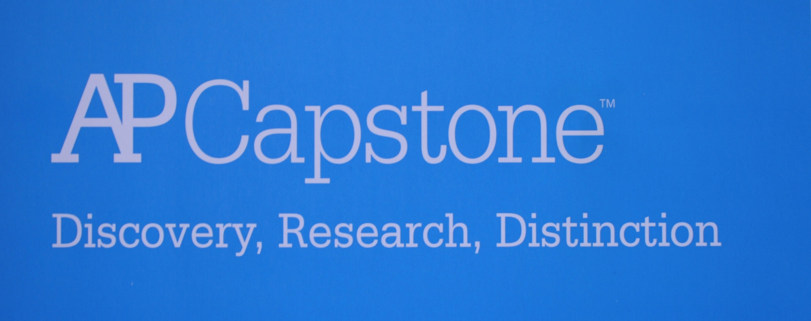
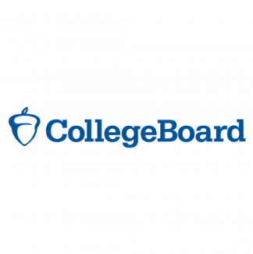
AP Capstone

Slide 8
AP Capstone was developed in response to feedback from higher education. The two AP Capstone courses, with their associated performance tasks, assessments, and application of research methodology, require students to:
Analyze topics through multiple lenses to construct meaning or gain understanding.
Plan and conduct a study or investigation.
Propose solutions to real-world problems.
Plan and produce communication in various forms.
Collaborate to solve a problem.
Integrate, synthesize, and make cross-curricular connections.

Slide 9
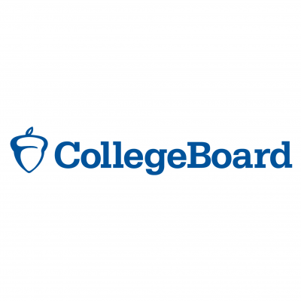
AP Capstone Diploma

Slide 10
AP Seminar
Students develop and strengthen analytic and inquiry skills, exploring two to four relevant issues chosen by the student and/or teacher.
Using an inquiry framework, students practice:
reading and analyzing articles
listening to and viewing speeches, broadcasts, and personal accounts
considering an issue from multiple perspectives, evaluating the strength of an argument, and making logical, fact-based decisions.
questioning, researching, exploring, posing solutions, developing arguments, collaborating, and communicating using various media
Notes:
For example, students might explore the question of whether national security is more important than a citizen’s right to privacy, or whether genetic engineering is a beneficial technology

Slide 11
AP Seminar Assessment
2 Performance tasks during course
Team project and presentation
Individual research-based essay and presentation
1 End-of-course exam
All 3 are used to determine final AP score (1-5)

Slide 12
AP Research
Allows students to design, plan, and conduct a yearlong research-based investigation on a topic of individual interest, documenting their process with a portfolio. This allows students to
demonstrate the ability to apply scholarly understanding to real-world problems and issues.
understand research methodology, employ ethical research practices, and access, analyze, and synthesize information to build, present, and defend an argument
Students may choose to do one of the following:
Dig deeper into a topic studied in an AP course.
Work across academic areas with an interdisciplinary topic.
Study a new area of interest, perhaps one for further study at the college level.

Slide 13
AP Research Assessment
1 academic paper of 4,000 to 5,000 words and a presentation with an oral defense
2 components of the through-course performance task are teacher-scored, and the academic paper is validated by the College Board after being scored. There is no end-of-course exam for AP Research.
Both are used to calculate the final AP score (1-5)

Slide 14
Support for Advanced Courses
AVID Advancement Via Individual Determination
Every student in this elective is taking advanced coursework and on a college going path.
Focus on identifying and gaining acceptance into the college of your choice
Twice a week tutorials with college students
College field trips to gain familiarity
College and scholarship application support

Slide 15
SAT School day
FREE for all 11th graders
Automatically signed up
March 21, 2018
Use SATPractice.org to prepare

Slide 16
Scholarship opportunities
11th grade PSAT score used for National Merit Scholarship Program
11th grade PSAT score used for National Hispanic Recognition Program
SAT scores (Evidence-based reading and mathematics) used for Florida Bright Futures Scholarship Program

Slide 17
Thank you!!
Hannah Graziano
grazianoh@pcsb.org
727-588-6044

